Slide 1
Graduate School 101
Explore and Apply to Graduate School at the University of Wisconsin-Madison
Wednesday, February 24, 2021 5-6:30PM

Slide 2
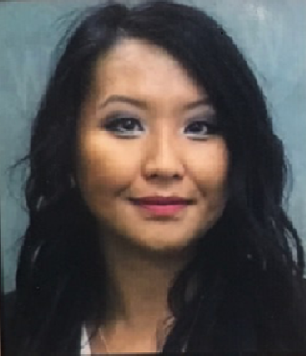
Diversity and Inclusion
Douachong (Doua) Lee
Multicultural Initiatives Manager
Office of Diversity, Inclusion & Funding
UW-Madison Graduate School
douachong.lee@wisc.edu

Slide 3
Why Graduate School?
Pursue scholarly interests/pursue a professional degree program
Make an impact
Develop intellectual relationships and lifelong networks
Pursue a career credential/career plan
Advancement in my job
Attain my personal goals (e.g., financial earnings)

Slide 4
Is Graduate School for Me?
What is the best department in my field of interest that I can get into?
What are the potential career(s) in my field of interest?
How much is it going to cost?
How long does it take to get through graduate school?
What do I want the degree to do for me?
Am I willing to invest the commitment to time, effort, and overall cost required?
Am I willing to persist, do hard work, and dedicate myself to my graduate study?

Slide 5
Things to know for First-Gen and Underrepresented Students
Step- out of your comfort zone
Start exploring early about post secondary education (e.g., interest, field of study, institutions, programs and faculty)
Build experience in the field, research and leadership
Network – Your Professors, TAs, Advisors, Supervisor, Peers, etc…
Ask questions!
Take advantages of opportunities as an undergrad
Be your authentic self!

Slide 6
Programming at UW Madison
Office of Diversity, Inclusion, and Funding Programs
Frequent mixer series based on your background
Community gatherings and professional development opportunities
Graduate student support groups
Graduate Research Scholars (GRS) Communities
Eight GRS communities based on your discipline
Designated funding opportunities
Frequent community gatherings and professional development opportunities
Summer Research Opportunities Program
Conduct summer research as an undergrad with UW Madison faculty
https://grad.wisc.edu/diversity/summer-research-opportunity-program/
Application Fee Grants
You can have your application fees paid for participating in select pipeline programs
https://grad.wisc.edu/apply/fee-grant/

Slide 7
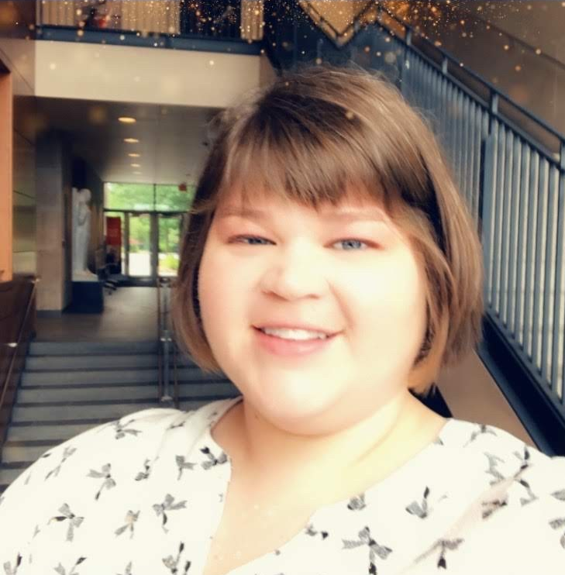
Admissions
Meleah Cue
Admissions and Academic Services Coordinator
UW-Madison Graduate School
meleah.cue@wisc.edu

Slide 8
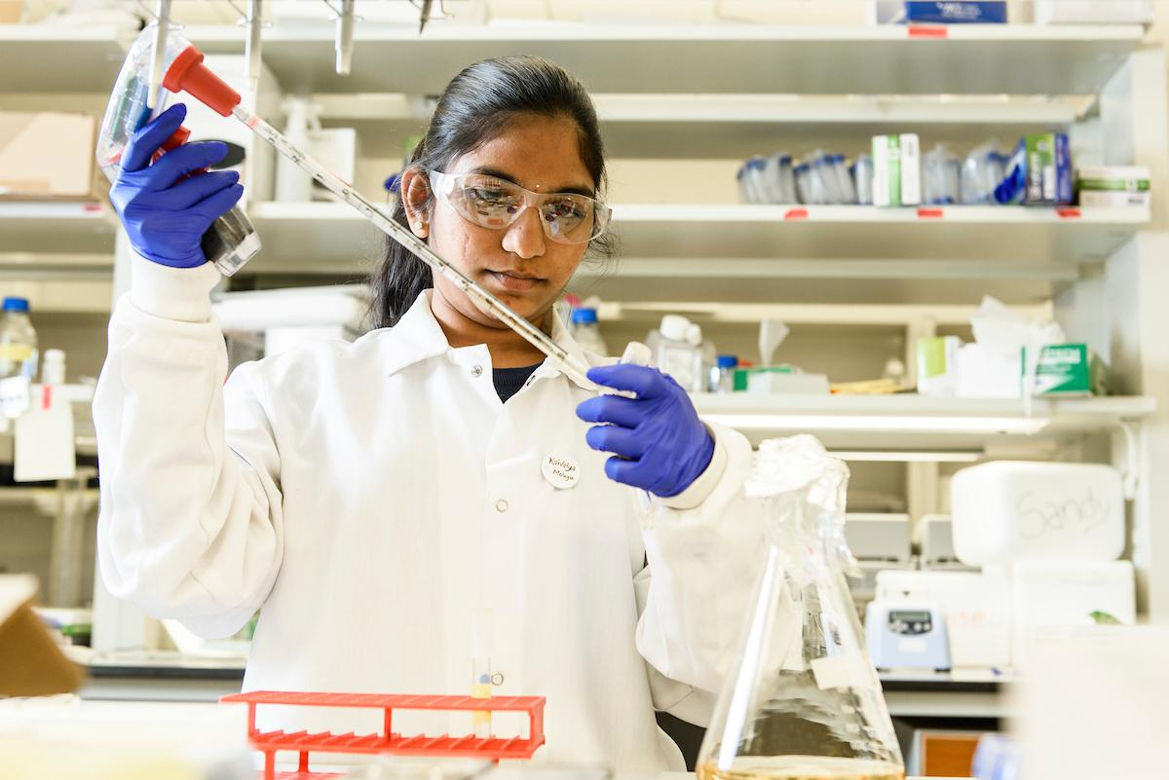
Areas of Study of Graduate/ Advanced Degree
Biological Sciences
Physical Sciences/ Engineering
Arts/Humanities
Social Sciences
Law
Medicine

Slide 9
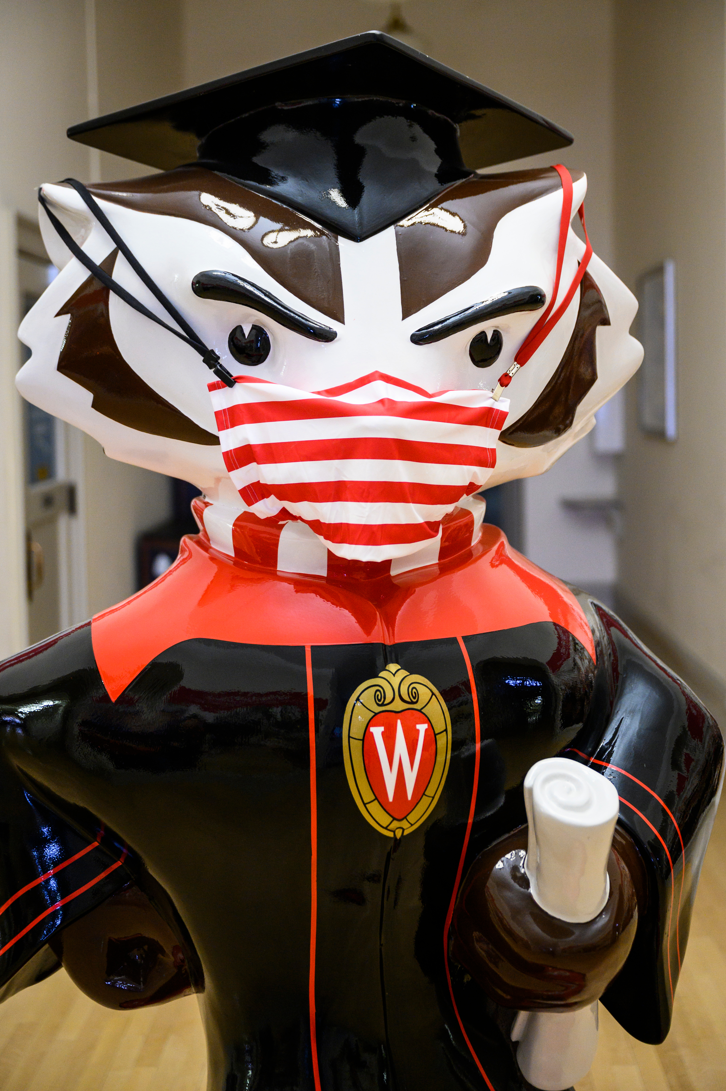
Deciding Which Program is Best for You
Explore the 158 Master's and 109 Doctoral Degrees offered at UW-Madison
Educate yourself on what options the programs offer
https://grad.wisc.edu/academic-programs/
Read about the program and explore more information at the program’s website

Slide 10
Application Process
Read the program’s website regarding minimum requirements and guidance on writing a statement of purpose
Find possible people to write letters of recommendation
Professional colleague, professor, former manager
Make sure you reach out to possible writers for your letters in advance
Educate your recommender on what you are applying for and how you are furthering your career
Is the GRE, LSAT, MCAT, or GMAT required?
Cost of the test
Preparing for the test date

Slide 11
Preparing for Your Interview
How to dress
Like a job interview
What to expect
What about the program made you apply?
How would the program fit into your future goals?
What do you know about the program/university/faculty?
You are also interviewing them
Will their program fit your interests?
Do they provide career services?

Slide 12
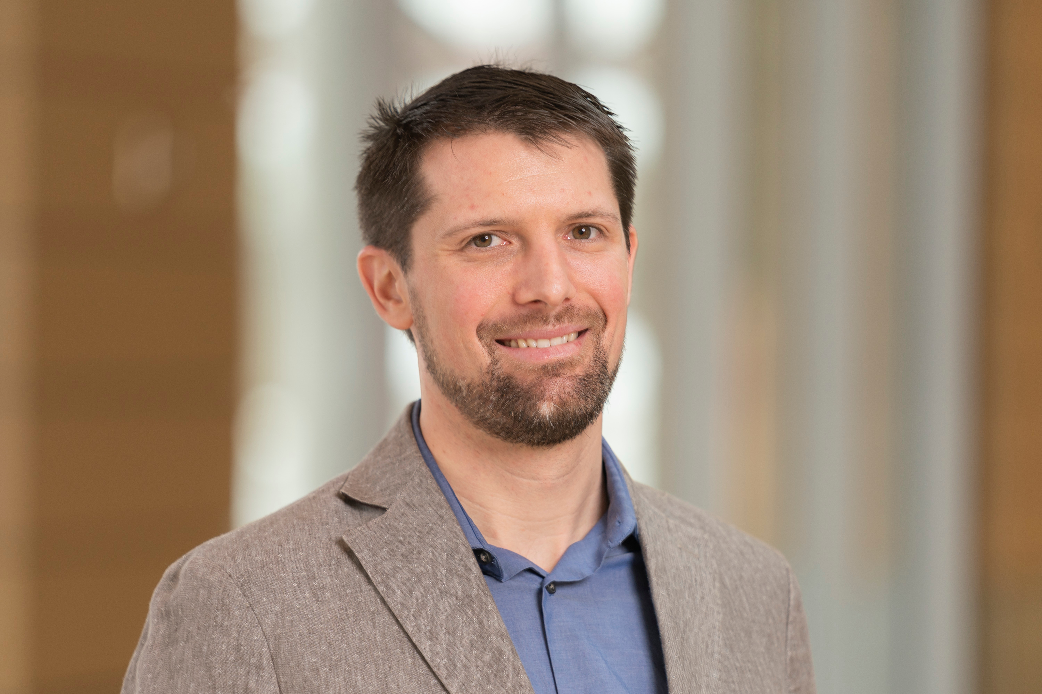
Funding
Nathaniel Haack
Fellowships Officer
UW-Madison Graduate School
Office of Diversity, Inclusion, and Funding
offr@grad.wisc.edu

Slide 13
Funding basics
Ask all programs you are considering apply to about their funding packages
Can be a combination of funding types
Evaluation of funding packages
Cost of living
Total compensation (stipend, benefits, paid time off, etc)
Years of guaranteed funding
Anticipated time to degree
Funding types and expectations

Slide 14
Graduate Assistantships
Work requirements
Generally come in three types: research, teaching, and program/project
Generally provide a stipend, tuition, and health insurance access
At UW-Madison, many assistantships are posted publicly on studentjobs.wisc.edu but most are awarded first by an internal process

Slide 15
Fellowships
No work requirements!
Fellowships can be short term (e.g. a summer semester) or cover multiple years
Each university has a different process for delegating fellowships, but many are targeted towards underrepresented and first-gen students
External fellowships – funded by outside agency,
The term “fellowship” has many definitions so pay attention to details
Check out our new external fellowship database!

Slide 16
Student Hourly and Off-Campus Employment
Generally do not cover tuition or provide health insurance access
Off campus jobs may provide assistance with tuition or educational fees. It never hurts to ask!
Most international student visas do not allow off-campus work
Be mindful of how many hours per week you can work while a student

Slide 17
Scholarships and other funding sources
Outside sources of supplemental funding
Scholarships (Wisconsin Scholarship Hub)
Funding for research travel or conferences (Student Research Grants Competition)
Assistance with childcare expenses (CCTAP, Head Start, 4C)
Emergency financial assistance (Crisis Loans)
Food assistance (Programs accessible at UW-Madison)
Assistance with housing, clothes, personal hygiene, et alii (2-1-1)
Financial Aid/Loans

Slide 18
Student Panelists
Cartecia Lawrence, MPA candidate, La Follette School of Public Affairs
Theodore Agbi, PhD Candidate, Chemical Engineering
Daniel Hayden, PhD Candidate, Plant Pathology
Gabrielle Tielman-Fenelus, JD Candidate, Law School
Juan Aguirre, MD Candidate, School of Medicine and Public Health
Na Lor, PhD Candidate, Educational Leadership and Policy Analysis

